Slide 1

Medical Insurance Cost Prediction Using Machine Learning
Presented By: Jerrina Ann Simon
Data Science Intern
Scifor Technologies
Student ID:STB03-T0015

Slide 2
Problem Statement
Health is essential for our complete well-being, which includes physical, emotional, mental, and social aspects.
Modern lifestyle often results in unhealthy habits that raise the price of activities and medical treatments.
This application enables users to handle the issues of rising healthcare expenditures in the modern world while encouraging financial responsibility and increasing health awareness.

Slide 3
Objective
The main goal of this project is to create a strong machine-learning model that can predict persons’ future medical expenses.
The secondary goal is to determine the key factors that influence the predicted medical expenditures to provide an understanding of the elements that determine healthcare prices.

Slide 4
Tech Stack used
Python programming
Pandas
Numpy
Matplotlib
Seaborn
Scikit learn
Streamlit

Slide 5
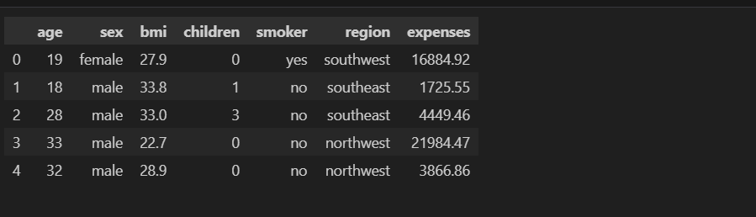
Dataset
The dataset is taken from Kaggle.
medical insurance dataset consisting of 1338 rows and 7 columns.
Includes essential data on medical expenses, with columns representing age, sex, BMI, children, smoker, region, and expenses.
'Expenses' is the target column as the primary objective is to predict medical costs;
The other columns are independent variables that feed into the prediction model.

Slide 6
Data Description
Age: The age of a person
Sex: The sex of the person(male, female)
BMI: It represents the body mass index.
Children: Total number of children a person has.
Smoker: Whether the person is a smoker or not
Region: Where the person lives considering four regions(Southwest, Southeast, Northeast, Northwest).
Expenses: It is a target column, representing the medical expense of a person.

Slide 7
Data Preparation
df.info(): provided concise information about data types and non-null counts for each column
df.dtypes: gives the details of the specific data types allocated to each
Df.describe(include="all"): provides a statistical overview, comprising both numerical and categorical columns.
There is no missing values in the dataset.
The dataset contain one missing values which is removed by using df.drop_duplicates() command.

Slide 8
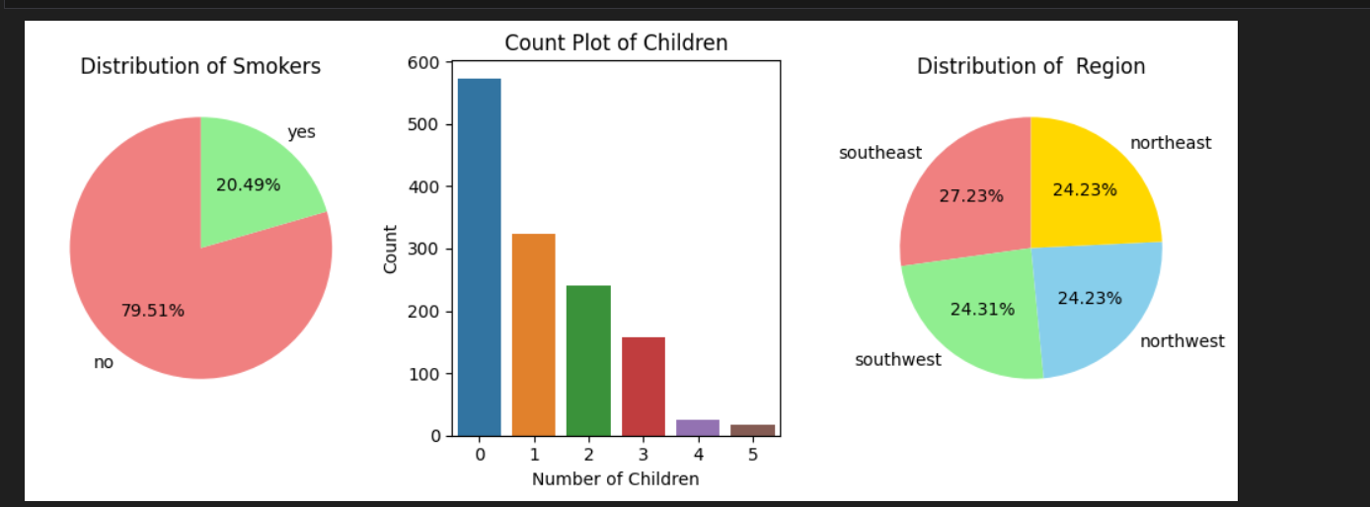
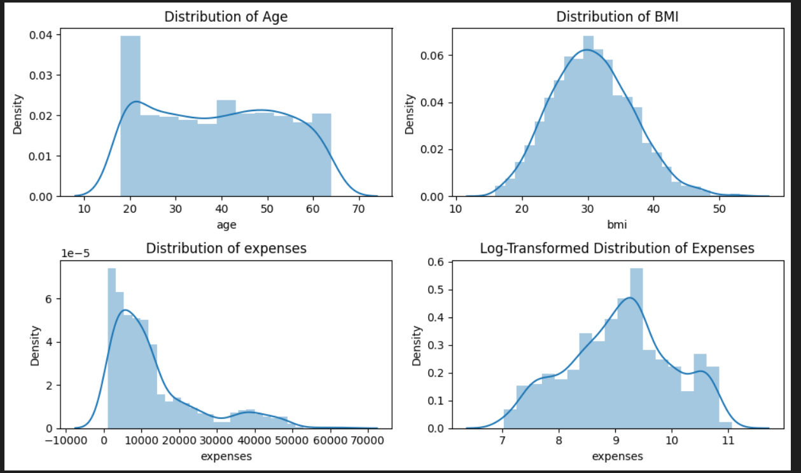
Data Visualization
UNIVARIATE ANALYSIS
The graph shows the Pie chart for the 'Smoker' column. A count plot illustrating the distribution of the 'Children' column. pie chart for showing the distribution of region.
Using distribution plots, the analysis of distribution focused on "Age," "BMI," and "Expenses," shows meaningful patterns. the 'Expenses' column showed a pattern that was skewed to the right, which led to the use of a log transformation for normalization by modeling assumptions.

Slide 9
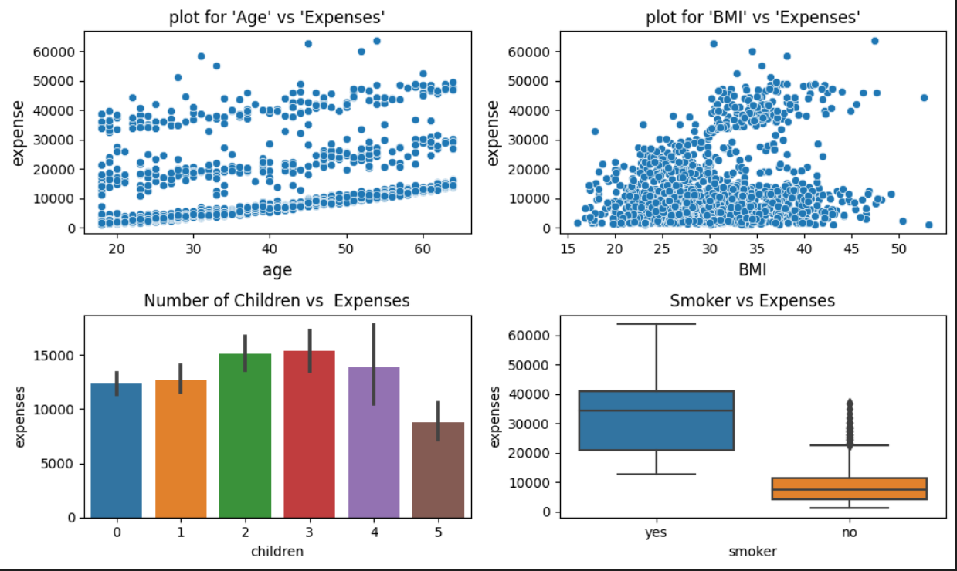
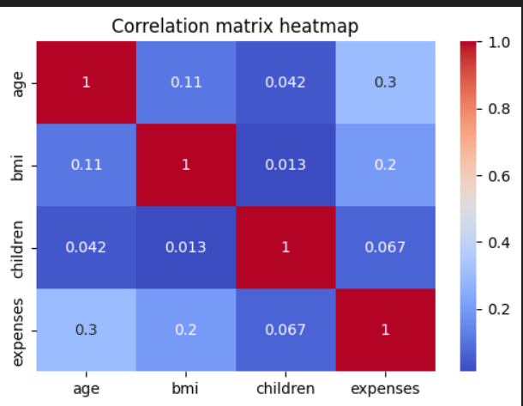
Bivariate Analysis Scatter plots were used to find correlations between key variables. 'Age' versus 'Expenses’ and "BMI" to "Expenses,“. Bar chart plot used to compare with number of "Children" and "Expenses" were positively correlated. Box plots showed that compared to non-smokers, smokers often had far greater medical costs.
Heatmap A heatmap visually illustrates the relationships among numerical variables in a dataset. with each cell representing the correlation coefficient between two variables.

Slide 10
Data Preprocessing
Encoding of the categorical column: Encoding is performed on the categorical column to convert the textual data to numerical format thus helping in learning patterns and relationships of data.
Train Test Split: Separates the dataset into the target variable (y) and independent variables (x). The following splits the data for training and testing sets.
Feature Scaling: feature scaling standardizes the range of independent variables in a dataset.

Slide 11
Hypothesis Testing
T-test T-tests were conducted to examine the relationship between 'sex' and 'smoker' status with respect to 'expense' variable. The Null Hypothesis, assuming equal mean expenses for different genders and smoking statuses, was rejected based on p-values of 0.033 and 1.4067e-282, respectively since the p-value is less than 0.05. These results underscore the significant impact of 'sex' and 'smoker' status on healthcare expenses.
ANOVA test The ANOVA test is chosen for its ability to analyze the differences in means among three or more groups. In this project, ANOVA was used to determine if the mean expenses varied significantly across different categories in the 'children' and 'region' columns. The rejection of the Null Hypothesis for both variables ('children': p = 0.00378, 'region': p = 0.0327) suggests significant differences in mean expenses across varying levels of children and regions.
Chi-Square test To determine if there is any correlation between categorical variables, the chi-square test is performed. The chi-square test was employed to assess correlations between categorical variables, specifically the 'Sex' and 'Smoker' columns. The significant p-value (0.006) and chi-square statistic (7.46) reject the assumption of no association, indicating a statistically significant relationship between the 'Sex' and 'Smoker' variables.

Slide 12
Model Building
Since the target variable is continuous in nature.
Regression algorithms such as Linear Regression, Random Forest Regressor, and Gradient Boost Regressor are used to get the best model

Slide 13
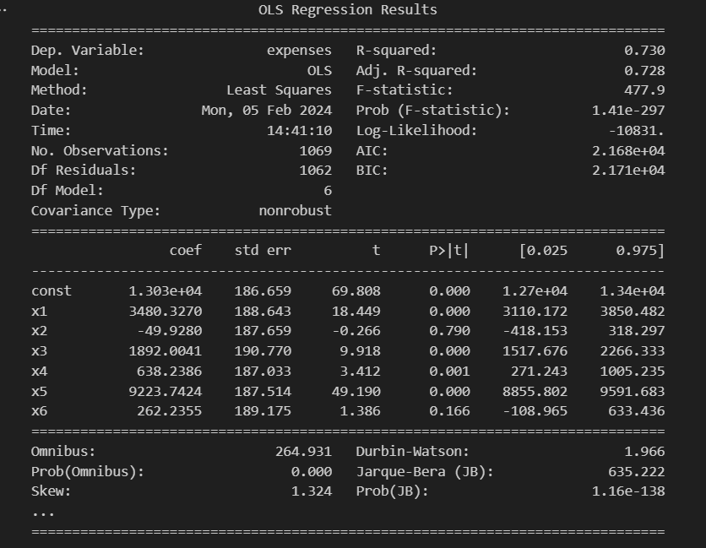
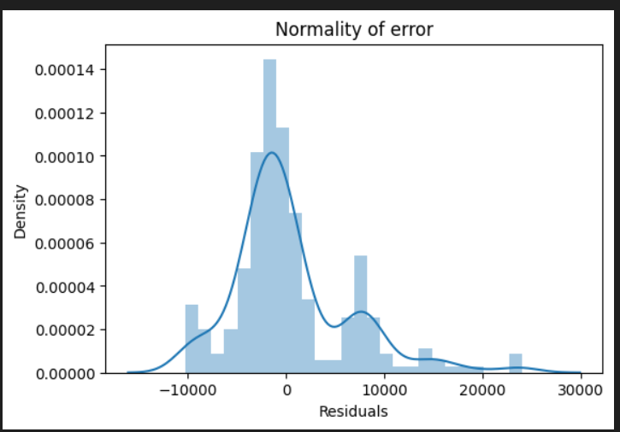
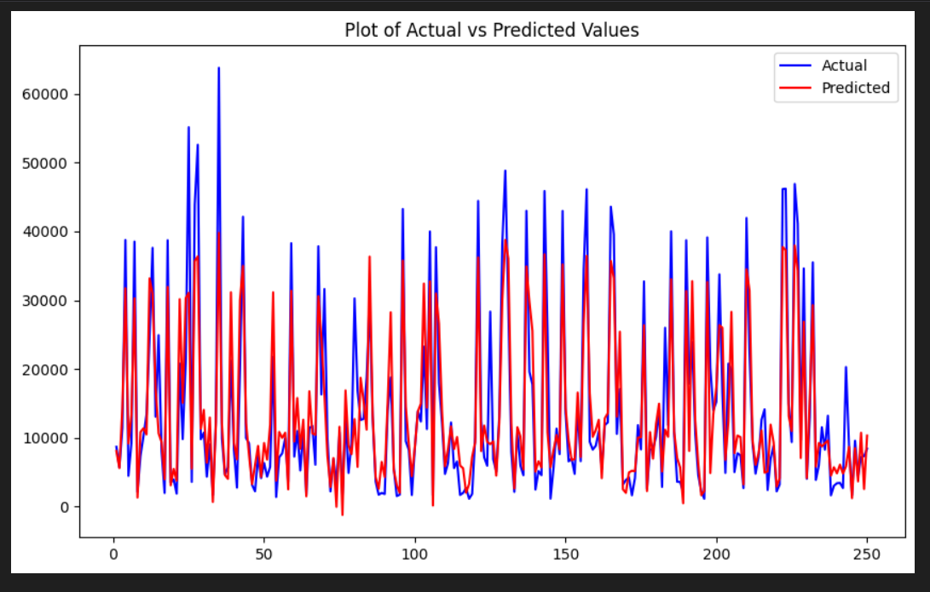
Linear Regression
Linear regression is employed to model the relationship between independent and dependent variables
The performance of the model is evaluated using evaluation metrics like mean absolute error, mean squared error, root mean square error, and R-squared score to access the accuracy of the model.
mean absolute error: 4182.597
mean squared error : 35496521.901
root mean squared error: 5957.896 r2_score: 0.807
residuals' normality is evaluated using a histogram.
A graph plotting the first 250 actual and predicted values provides visual insight into the model's performance and data distribution.
Statsmodels is utilized to generate a comprehensive statistical summary

Slide 14
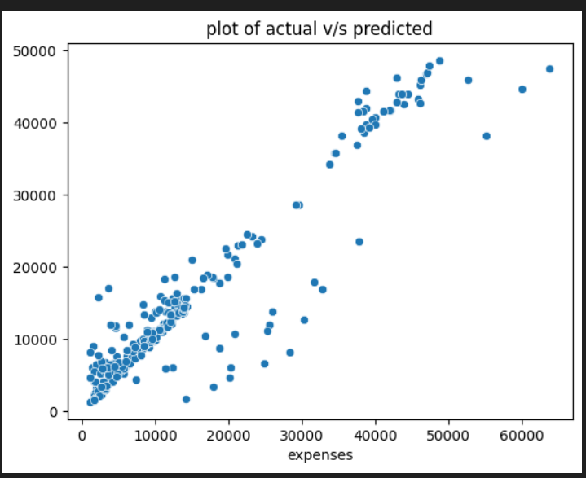
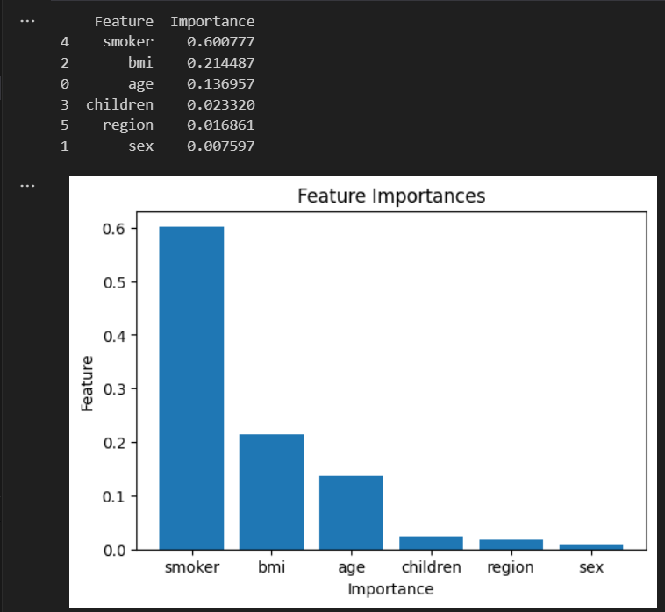
Random Forest Regressor
The Random Forest Regressor is an ensemble learning approach, that combines multiple decision trees to enhance predictive accuracy.
It's evaluated using metrics like mean absolute error, mean squared error, root mean square error, and R-squared score.
Feature importances are also computed to understand which features are most important for the predictions, making it a reliable method for various regression tasks.

Slide 15
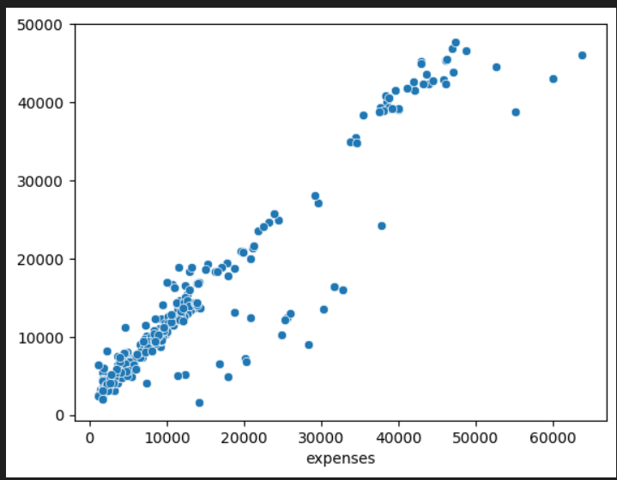
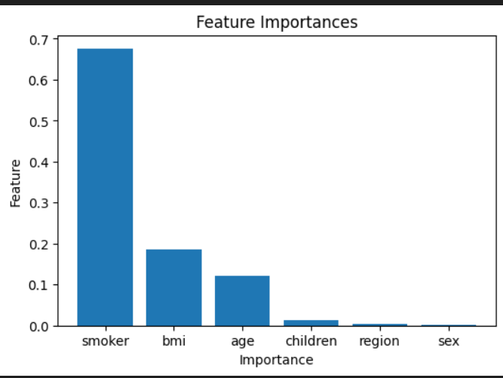
Gradient Boosting Regressor
Gradient Boosting Regressor, a sequential ensemble learning algorithm, builds decision trees in a way that each tree corrects the errors of the previous ones, resulting in accurate predictions.
It's evaluated using metrics like mean absolute error, mean squared error, root mean squared error, and R-squared score, known for capturing complex data relationships effectively.
Feature importances are computed to understand each feature's contribution to the predictions, making
Gradient Boosting Regressor a versatile and reliable algorithm for various regression tasks.

Slide 16
Cross-Validation
Cross-validation, a vital resampling method for assessing machine learning models on small datasets, involves iteratively training and testing models with 'k' set to 5 in this project.
Among the three evaluated models, the Gradient Boosting Regressor achieved the highest mean score of 0.833, suggesting superior performance in predicting medical expenses.
Cross-validation ensures accurate model evaluation and selection, crucial for obtaining reliable predictions and optimizing model performance.
Mean Cross-Validation Score (Linear Regression): 0.725 Mean Cross-Validation Score (Random Forest): 0.816 Mean Cross-Validation Score (Gradient Boosting): 0.833 Best Model: Gradient Boosting Regressor Test Set Score (R2): 0.89

Slide 17
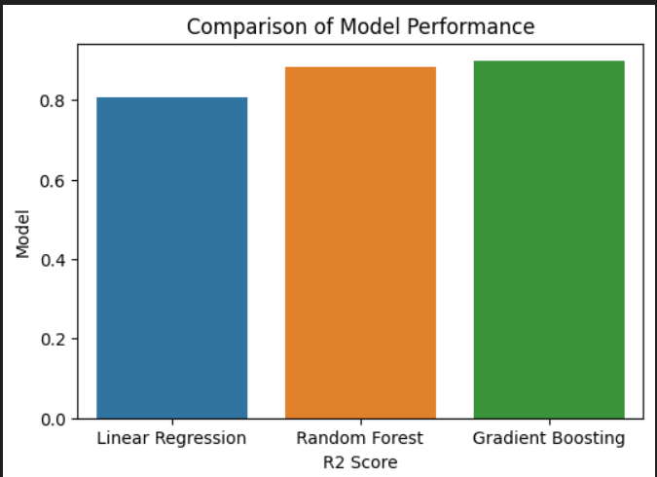
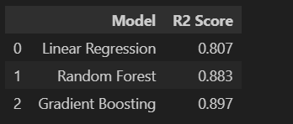
Comparison
Arrays for R2 scores and labels were created for Linear Regression, Random Forest, and Gradient Boosting models, with the bar plot indicating that Gradient Boosting outperformed the others, making it the preferred choice for predicting medical expenses.
Similarly, Linear Regression exhibited the lowest effectiveness.
This comparison highlights the importance of selecting the most accurate algorithm for medical expense prediction, emphasizing the successful development and evaluation of predictive models.

Slide 18
Deployment
A medical insurance cost prediction model is deployed using the Streamlit framework, allowing users to access it through a user-friendly interface.
Users input information such as age, sex, BMI, number of children, smoking status, and region, and upon clicking 'Predict', the model, loaded from 'trained_model.joblib_1’,
Processes the data to provide a real-time prediction of the insurance cost.
This Streamlit app enables convenient access to medical expense predictions through a web link, enhancing user interaction and accessibility.

Slide 19
Thank you

